Slide 1
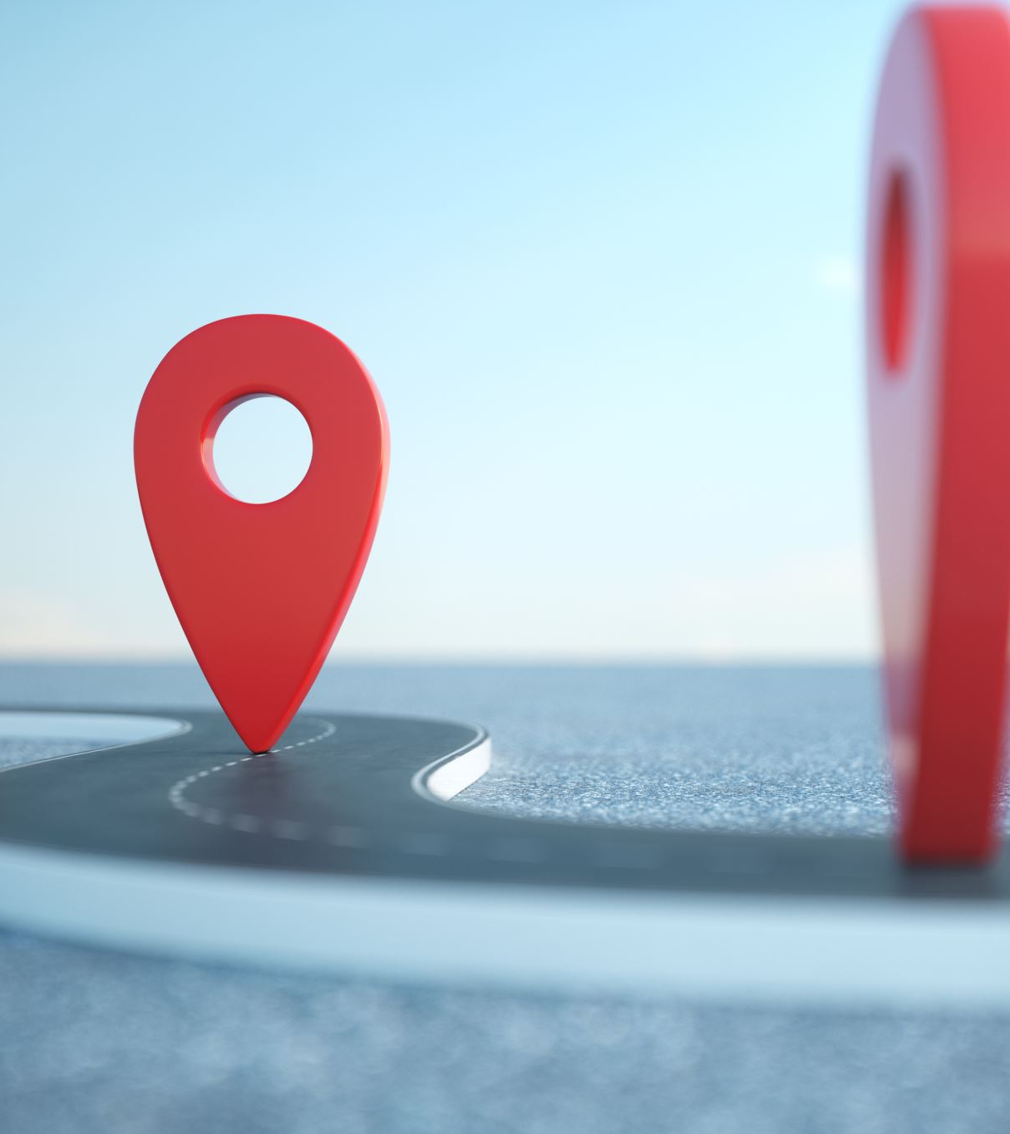

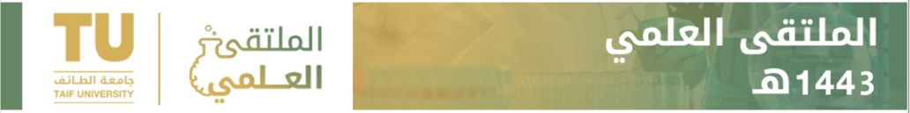


Smart Tourism
Department of Computer Science Collage Computer and Information Technology
Alamri. A, Alghamdi. A, Alharthi. B, Almalki. B, Ayoub. O, Alshehri. W
Advisor: Dr. Fahad Alharthi

Slide 2
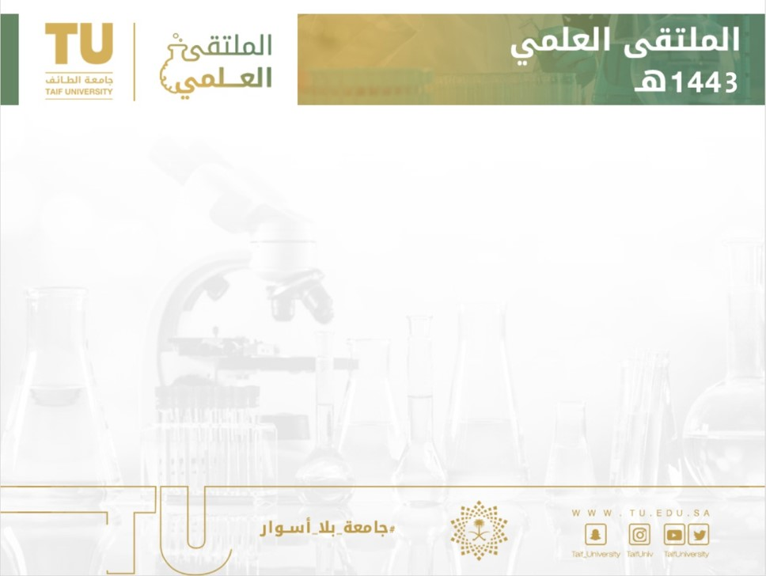

Abstract
In Saudi Arabia, tourism is one of the most important aspects in 2030 vision.
Tourism in Saudi Arabia has been witnessing rapid growth in recent times and opening new horizons for the tourism industry.
Create a tourist application for the cities of the Kingdom of Saudi Arabia since it’s needed for tourists who visit the country.
The goal of the application is to guide tourists to the best areas in the city then direct them to tourist places.
This application aims to facilitate the scheduling and organization of trips.

Slide 3

Problem Background
Determining the best places to visit
Lack of experience in tourism
Difficulties of scheduling and manage tourist plan.

Slide 4


What is Smart Tourism?
Facilitate the digital and physical services to the tourists pre/during/post the trip.
Fields of Smart Tourism
Tourists References
Tourism Services
Recommender System
Crowd System

Slide 5
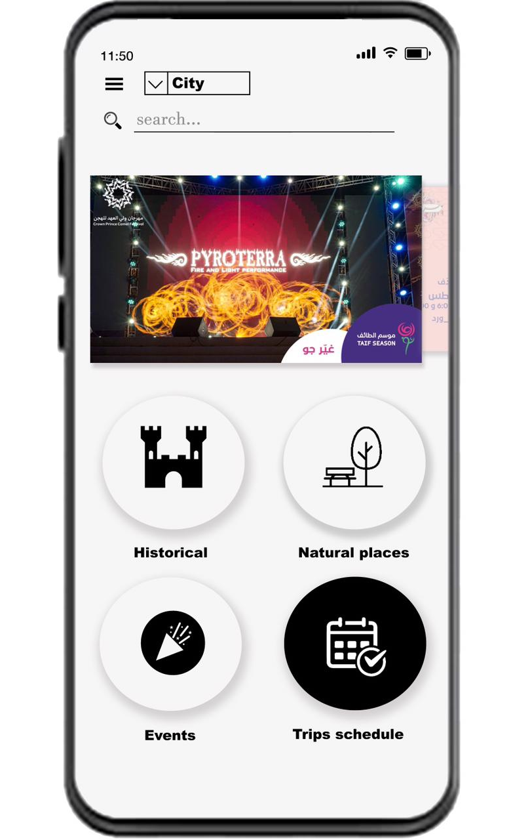
What is Dalilak System?
The system is related to smart tourism works; it serve tourists as expert recommender system.
Main Features:
Automated scheduling.
Hiring tour guides.
Monitor the system and AI.

Slide 6
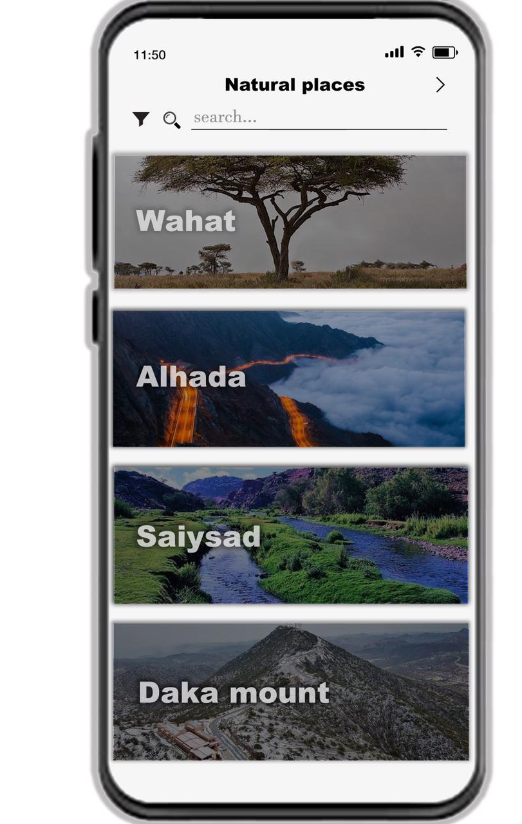
What is Dalilak System?
The system is related to smart tourism works; it serve tourists as expert recommender system.
Main Features:
Automated scheduling.
Hiring tour guides.
Monitor the system and AI.

Slide 7
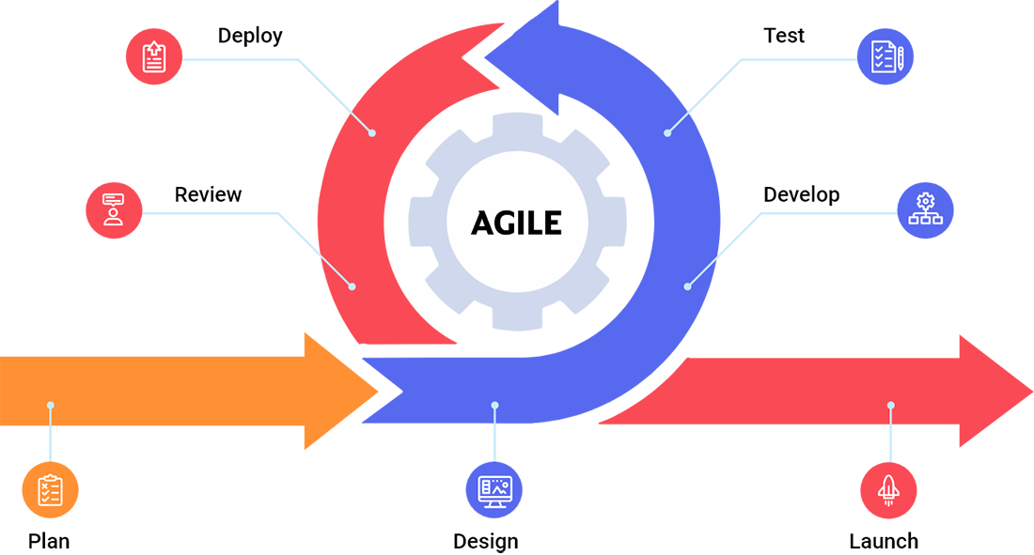
Methodology
Requirements
Design Life Cycle
Evaluation
Release

Slide 8
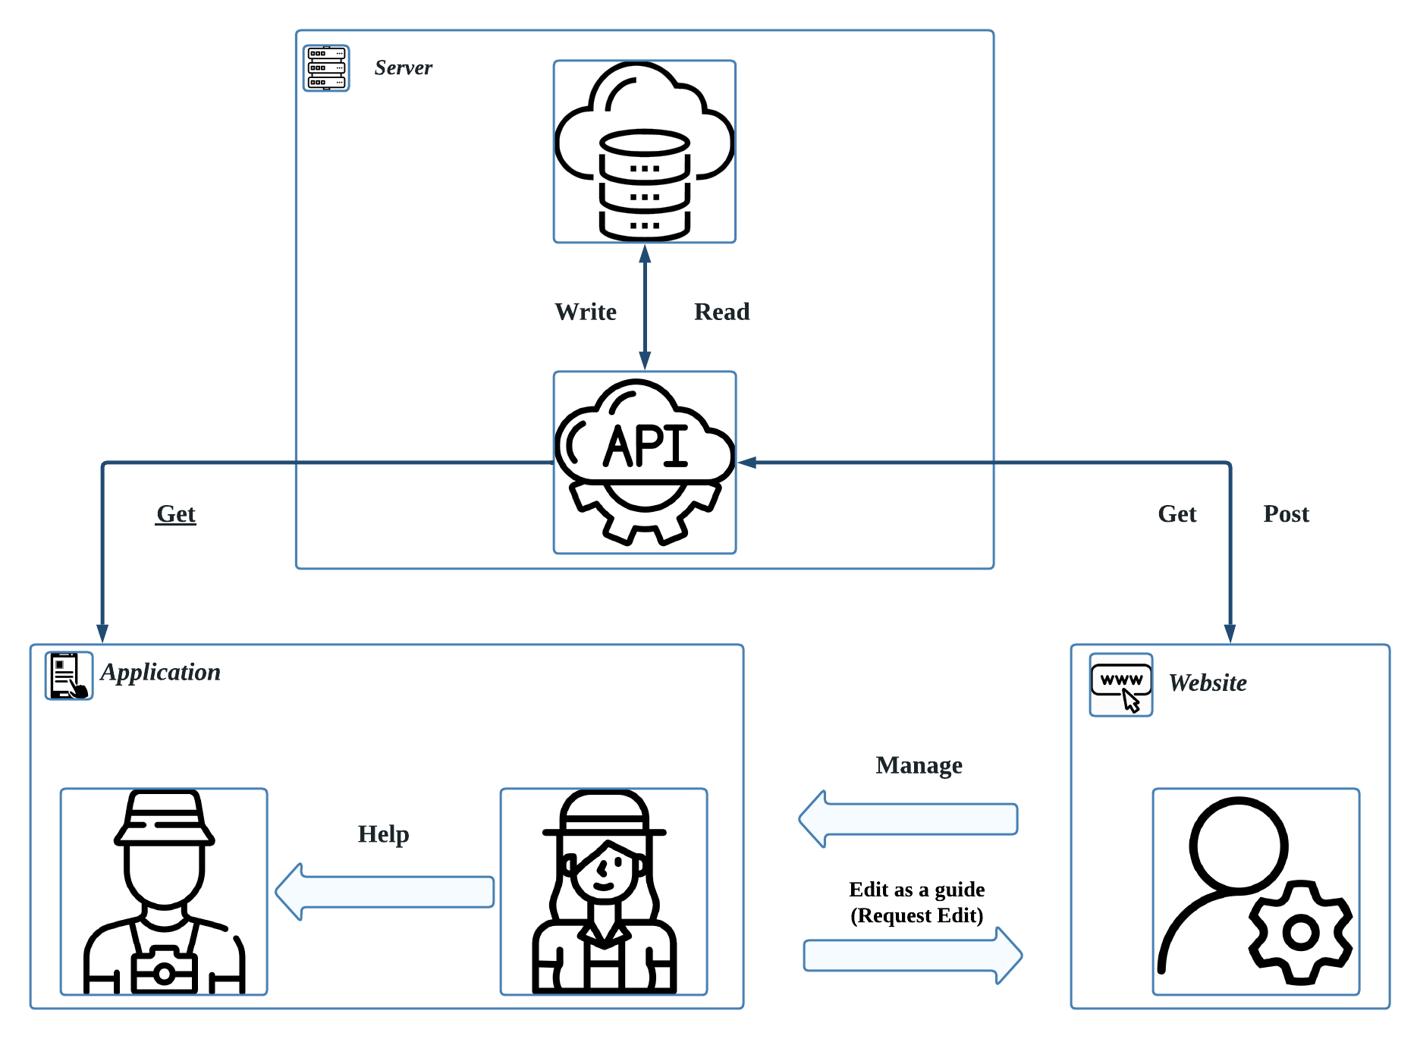
System Analysis

Slide 9

Artificial Intelligence (Machine Learning)
Linear Regression
Matrix factorization

Slide 10
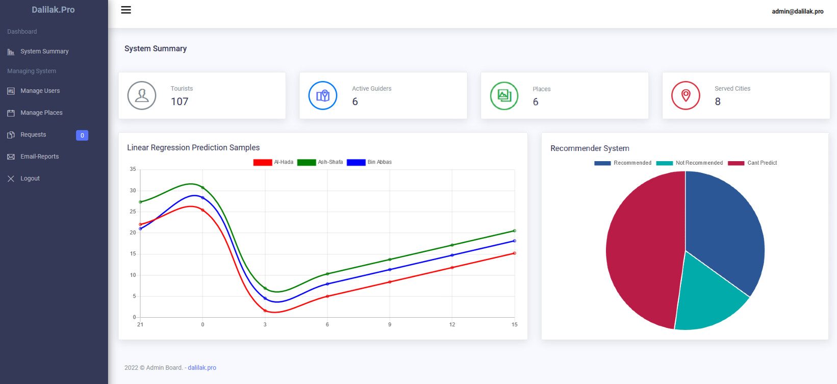
Website

Slide 11
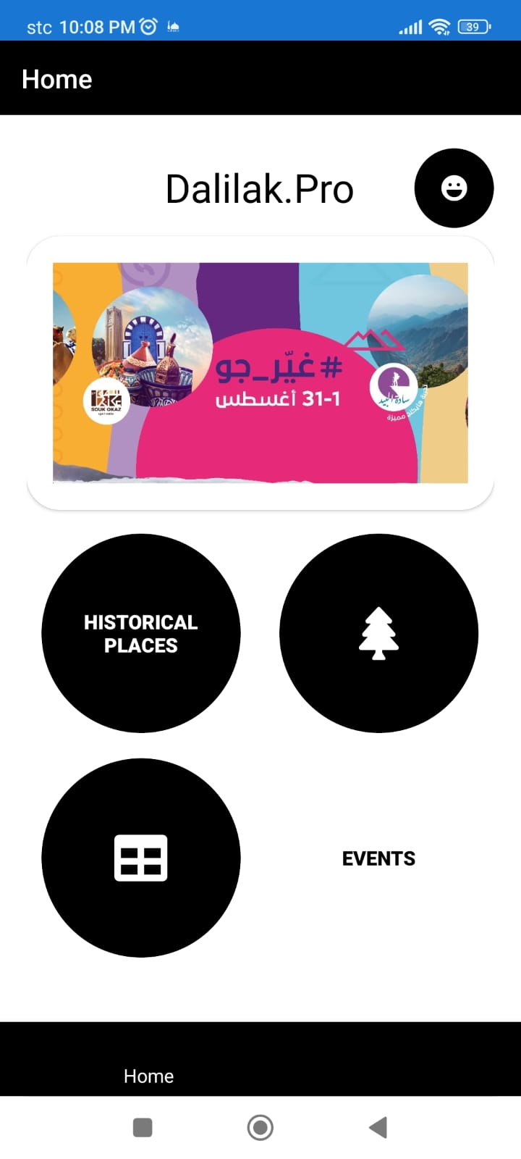
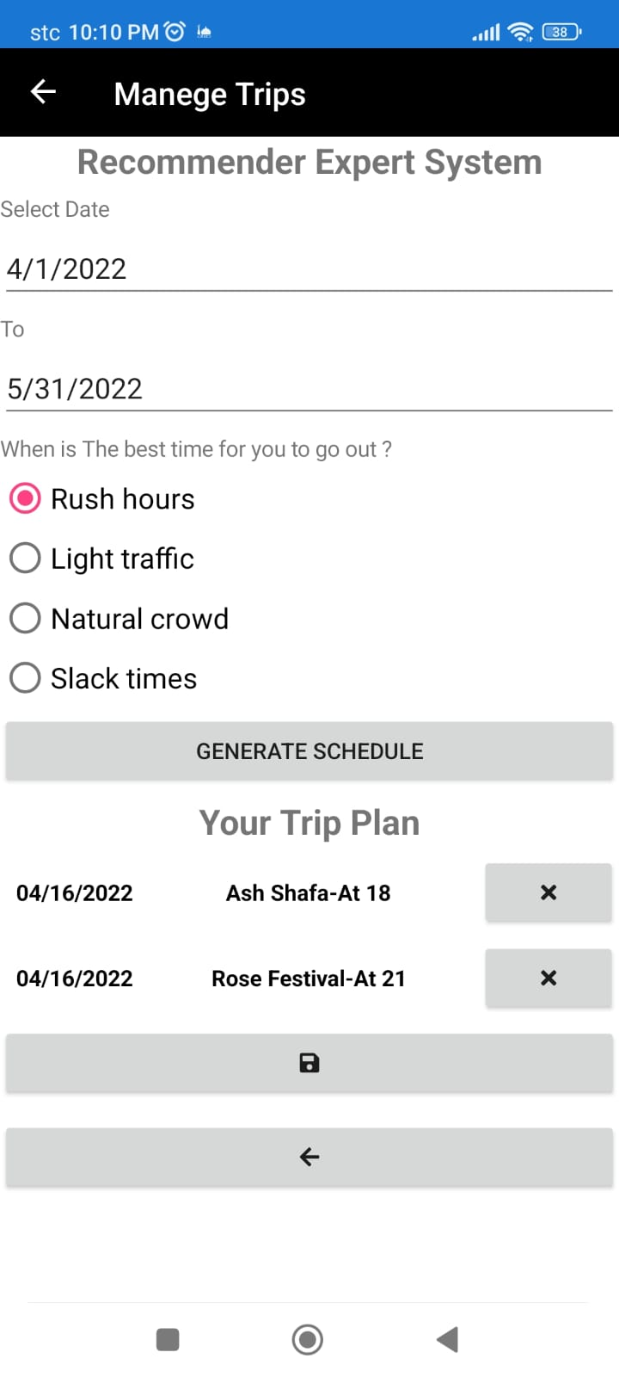
Application

Slide 12
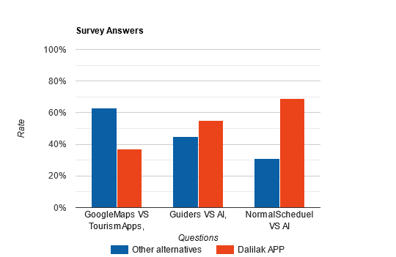
Survey Results (Evaluation)

Slide 13

Future Work
Scale the scope of the system
Add expert chat bot to guide the tourists.
Add e-commercial dashboard

Slide 14
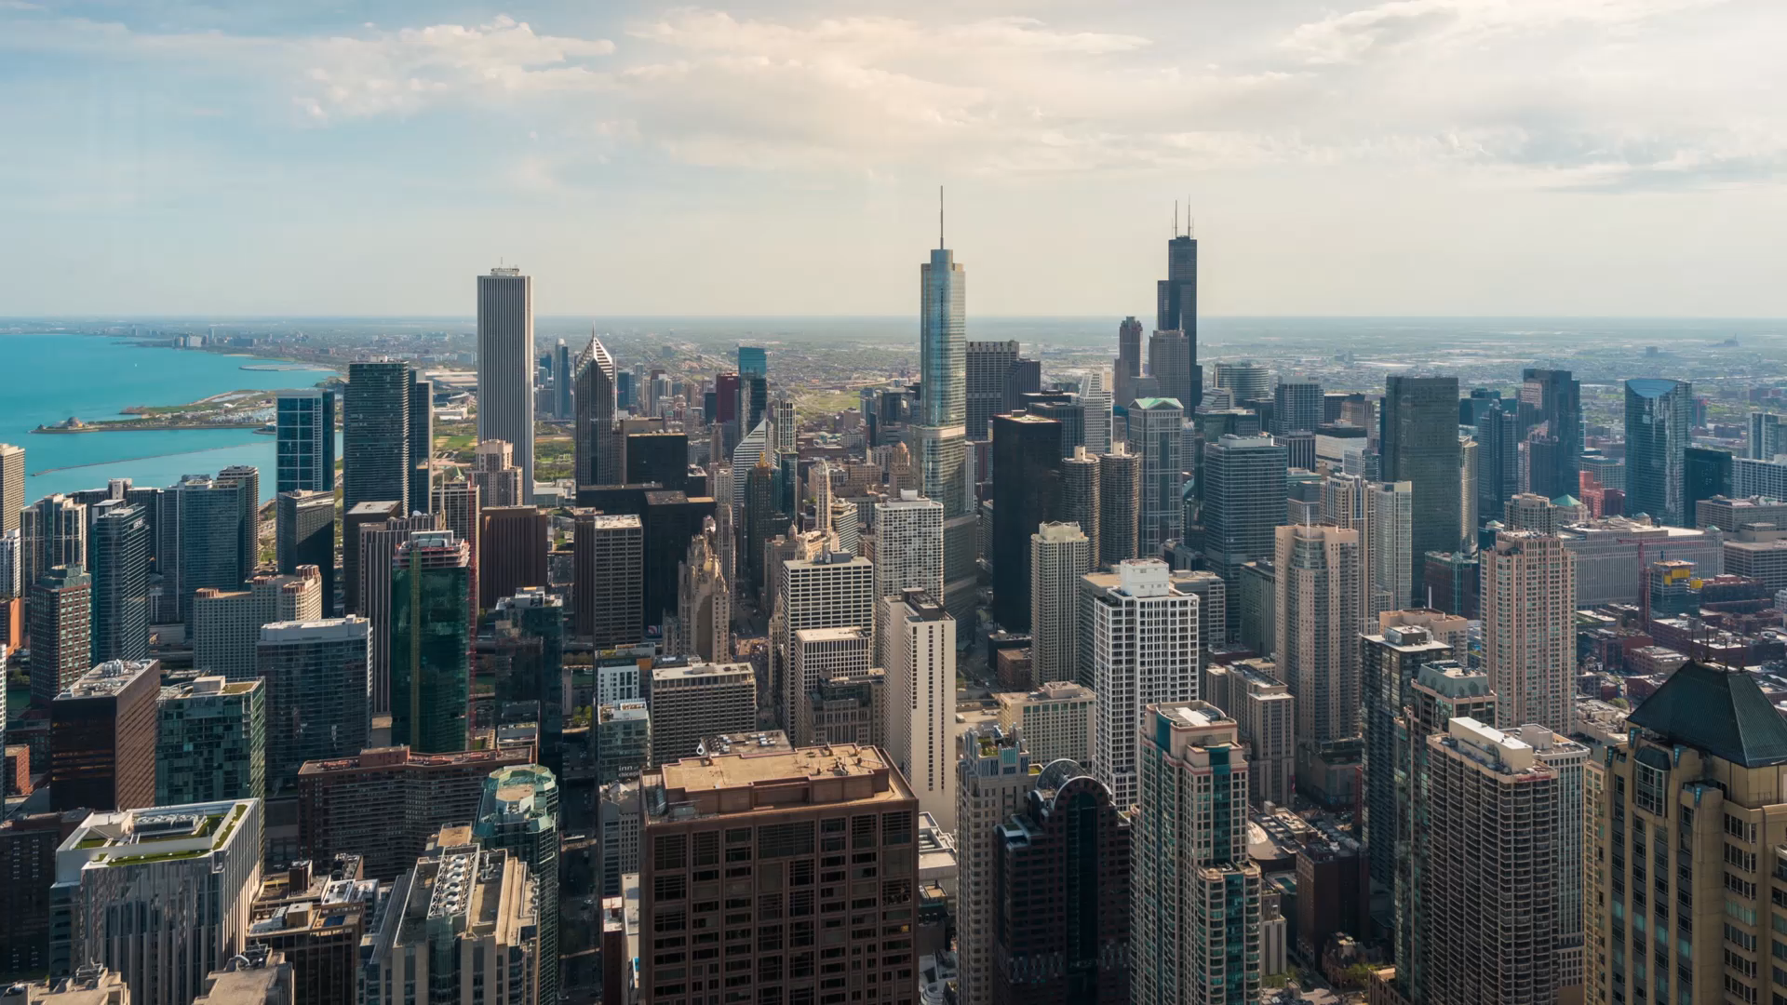
Smart Tourism (Conclusion)

Slide 15
Q & A Thank You for listening

Slide 16
Resources
Ulrike G, Marianna S, Zheng X & Chulmo L, 2015, ‘Electronic Market’, Smart tourism: foundations and developments, n.25, pp.179-183.
Lucid Content Team. 4 Phases of Rapid Application Development Methodology. Available at: https://www.lucidchart.com/blog/rapid-application-development-methodology (Nov. 2021)
Deepanshi. 2021. ‘Data Science Blogathon’. All you need to know about your first Machine Learning model – Linear regression. Available at: https://www.analyticsvidhya.com/blog/2021/05/all-you-need-to-know-about-your-first-machine-learning-model-linear-regression/ (Nov. 2021).
Michael G. 2021. Machine Learning – Samples. Available at: https://github.com/dotnet/machinelearning-samples/tree/main/samples/csharp/getting-started/MatrixFactorization_ProductRecommendation (Nov. 2021).

